Slide 1
Capstone Project - 1
Hotel Bookings Analysis
Team Members
Ritesh Shekhar Rajurkar
Bapu Bordekar

Slide 2
Content
Problem Statements
Data Summary
Analysis of Data
Challenges
Conclusions
List

Slide 3
Problem Statements
When is the worst time to go to Portugal? - Customer
What kind of people go to Portugal? - Facilitator/Owner
What impacts cancellations? - Owner

Slide 4
Data Summary
The dataset spans over three years - 2015, 2016 and 2017.
1. 'hotel': Denotes the type of hotel - Resort hotel or city hotel
2. 'canceled': Denoted by '1' if booking was cancelled or '0' otherwise
3. 'lead_time': Period between time of booking and checking in (considered in days here)
4. ‘arrival_date_month’ : The month the customer arrived at the hotel
5. ‘country’: The country of origin of the customer; has 158 countries listed
6. ‘adr’: Average rental revenue earned for an occupied room per day
7. [Additional] Booking category: ‘individuals’, ‘couples’ and ‘family’

Slide 5
Data Summary (contd)
Assumptions:
1. Rows where the ADR reads zero but the status reads 'check-out' have been ignored
2. Rows where the number of people sums up to zero, but the status reads 'check-out' have not been considered
3. Market segments are considered distribution channels

Slide 6
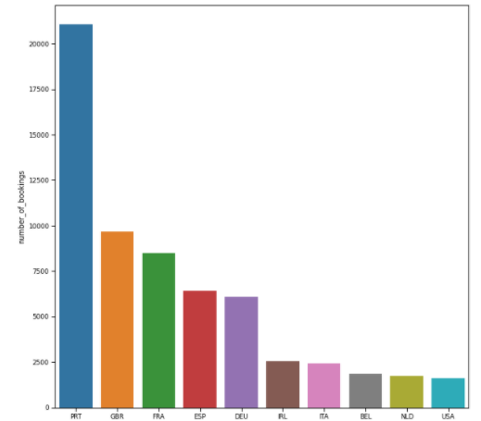
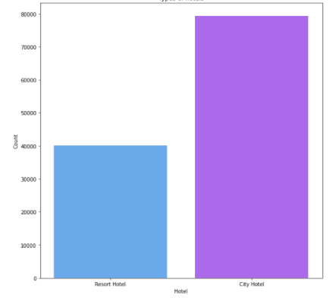
Customer: Portugal, here we come...or not
Top 10 countries by number of bookings
Break-up of types of hotels

Slide 7
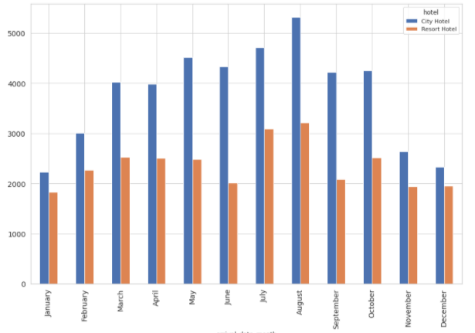
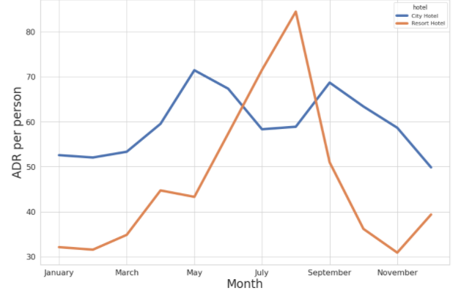
Customer: Portugal, here we come...or not
Break-up of most busy months by type of hotel
ADR trends over the months
Fun fact: School summer breaks in Portugal are between mid-June and mid-September

Slide 8
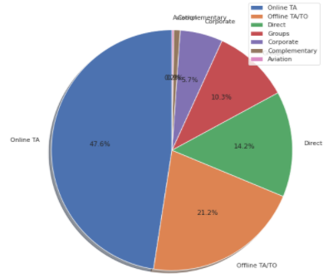
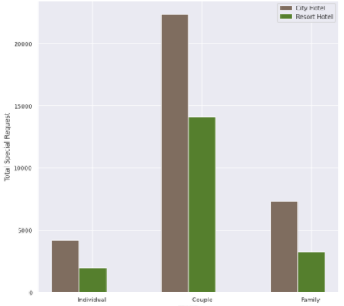
Facilitator/Owner: Who does the booking?
Break-up of distribution channels
Types of bookings during 2015-2017

Slide 9
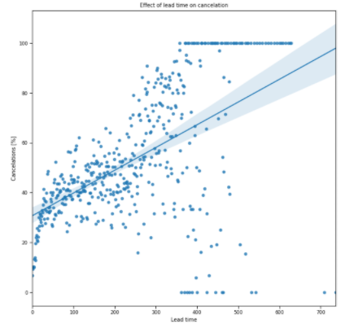
Owner: What impacts cancellations?
Effect of lead time on cancellations

Slide 10
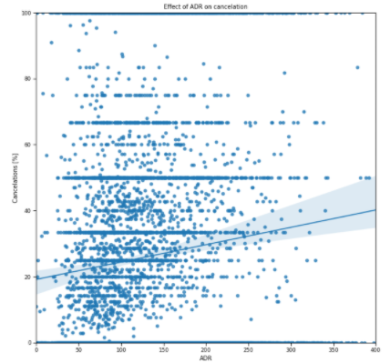
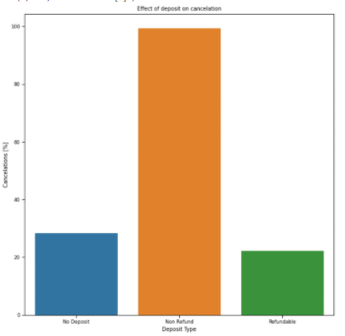
Owner: What impacts cancellations?
Effect of ADR on cancellations
Effect of deposit type on cancellations-

Slide 11
Challenges
Time taken to articulate the problem statements
Room upgrade analysis
Consideration of data subsets
Number of cancellations for bookings is the highest (~95%)

Slide 12
Conclusions
Worst time to head to Portugal: July and August
What categories should facilitators/owners focus on: The highest number of bookings are done by couples for both segments
A leading indicator of cancellations is high lead time

Slide 13
Q & A

